Slide 1
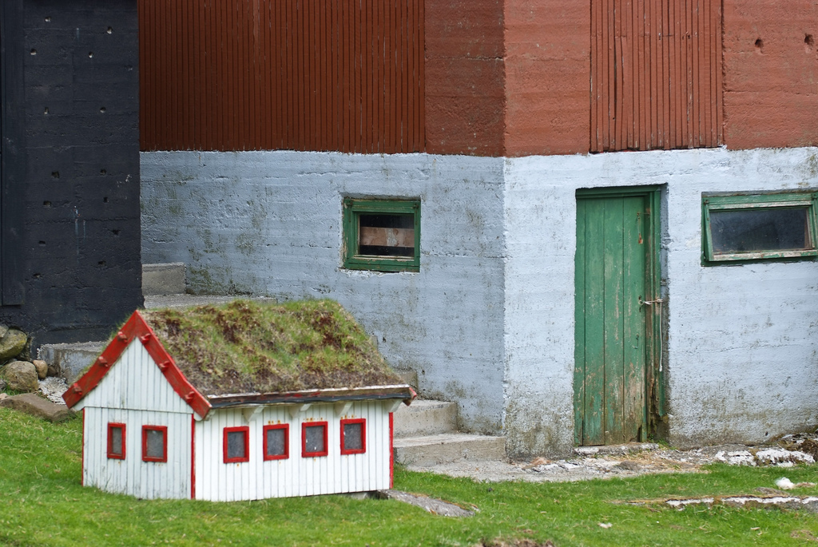
Software Engineering Processes
http://www.flickr.com/photos/arne-list/2586460111/sizes/l/

Slide 2
Do you want to build “dog houses” or “high rises”?
If you want to build a dog house, you can pretty much start with a pile of lumber, some nails, and a few basic tools, such as a hammer, saw, and tape measure. In a few hours, with little prior planning, you'll likely end up with a dog house that's reasonably functional...
If you want to build a high-rise office building, it would be infinitely stupid for you to start with a pile of lumber, some nails, and a few basic tools. Because you are probably using other people's money, they will demand to have input into the size, shape, and style of the building.... You will want to do extensive planning, because the cost of failure is high. You will be just a part of a much larger group responsible for developing and deploying the building, and so the team will need all sorts of blueprints and models to communicate with one another....
-- Grady Booch, The Unified Modeling Language User Guide
http://www.amazon.com/Unified-Modeling-Language-Addison-Wesley-Technology/dp/0201571684

Slide 3
Do you want to build “dog houses” or “high rises”?
If you want to build a dog house, you can pretty much start with a pile of lumber, some nails, and a few basic tools, such as a hammer, saw, and tape measure. In a few hours, with little prior planning, you'll likely end up with a dog house that's reasonably functional...
If you want to build a high-rise office building, it would be infinitely stupid for you to start with a pile of lumber, some nails, and a few basic tools. Because you are probably using other people's money, they will demand to have input into the size, shape, and style of the building.... You will want to do extensive planning, because the cost of failure is high. You will be just a part of a much larger group responsible for developing and deploying the building, and so the team will need all sorts of blueprints and models to communicate with one another....
-- Grady Booch, The Unified Modeling Language User Guide
http://www.amazon.com/Unified-Modeling-Language-Addison-Wesley-Technology/dp/0201571684

Slide 4
Do you want to build “dog houses” or “high rises”?
If you want to build a dog house, you can pretty much start with a pile of lumber, some nails, and a few basic tools, such as a hammer, saw, and tape measure. In a few hours, with little prior planning, you'll likely end up with a dog house that's reasonably functional...
If you want to build a high-rise office building, it would be infinitely stupid for you to start with a pile of lumber, some nails, and a few basic tools. Because you are probably using other people's money, they will demand to have input into the size, shape, and style of the building.... You will want to do extensive planning, because the cost of failure is high. You will be just a part of a much larger group responsible for developing and deploying the building, and so the team will need all sorts of blueprints and models to communicate with one another....
-- Grady Booch, The Unified Modeling Language User Guide
http://www.amazon.com/Unified-Modeling-Language-Addison-Wesley-Technology/dp/0201571684

Slide 5
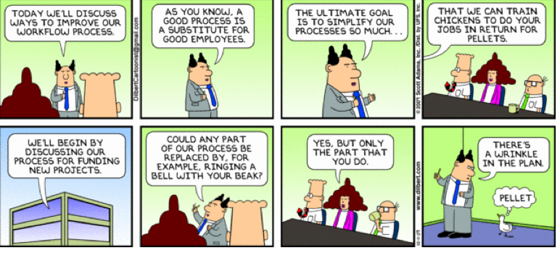
Processes

Slide 6
But first, some housekeeping
Accessing Syllabus, Schedule – Canvas
Piazza – the place to get answers
Announcements – Canvas or Piazza?
Why no laptop policy?
Assignment – Vision V1 – due today: 11:59 pm
Submit to vision-v1-DUE (09/29)
Voting on Friday!!

Slide 7
Development process
Process = a set of ordered tasks
Typical software tasks:
Figuring out what the system should do (requirements)
Figuring out how the system should do it (design)
Writing the code for the system (implementation)
Making sure that the code is right (testing)
Using the system (operation)
Should imply some planning and risk management
Different processes order tasks differently

Slide 8
Requirements analysis
Ways to figure out what the system should do:
Get the customers to write down what they want
Talk with customers and make some diagrams
Watch users in “daily life” to see what they need
Look up the requirements from a standards body
Gather with customers, users, and your fellow engineers to discuss/argue/negotiate a contract
Any combination, variation, or extension of the above

Slide 9
Design
Architectural design
Figuring out the overall structure of the system
What components should be in the system?
How should the components be connected?
Program design
Figuring out how code should be organized
How should each component’s code be distributed among classes and/or functions?

Slide 10
Implementation
Finally, we get to write some code!
Implementation also may include:
Writing comments
Writing other documentation
Helping fellow engineers with their coding
Answering questions
Reading colleagues’ code, documentation, etc
Messing around with code until it “smells good”
http://www.ipedr.com/vol45/012-ICMTS2012-G10008.pdf
Notes:
22 smells: helps with maintainability == refactoring. Critique: 22 is too many. And intuition trumps metrics

Slide 11
Testing
Testing
Unit testing
Good for automatically checking individual components
System integration testing
Good for checking that components work well together
Usability testing
Good for checking user interfaces
Acceptance testing
Good for checking that the customer/user is happy

Slide 12
Operation
The code compiles, passes all tests, and looks great on your desktop. Done, right?
Operation often includes
Distributing code to customers/users
Providing documentation and support
Debugging, after users try out the system
Studying how well the system works in practice
Adapting the system for new markets
Wrong!

Slide 13
So…. What does a process look like?

Slide 14
Waterfall
Characteristics:
Document-driven
Design up-front
Distinct phases in timeline
Customer not involved until deployment
Requirements
Design
Implementation
Testing
Operations
Notes:
First 1950, popularized in 1970. There are different fl

Slide 15
Waterfall
First introduced in 1950, popularized in 1970
Forced discipline, planning, & management into software development
Postpone implementing the product (get out of the routine of build and fix) until after objectives are well understood
What issues does this cause?
Notes:
Time lag between requirement elicitation & delivery
Rigidity – separate teams, communication issues
Separate teams: they are working on something else by now
Lack of anticipation of change
No phase for business / risk planning
Non-iterative: hard to handle changes to products and activities during development (assumes requirements can be frozen)
Views software development as manufacturing process rather than as creative process

Slide 16
Drawbacks of The Waterfall Model
Non-iterative: hard to handle changes to products and activities during development (assumes requirements can be frozen)
Rigidity – separate teams, communication issues
Separate teams: they are working on something else by now
Lack of anticipation of change
No phase for business / risk planning
Non-iterative: hard to handle changes to products and activities during development (assumes requirements can be frozen)
Views software development as manufacturing process rather than as creative process
Long wait before a final product
Customer not involved until the final product unveiling

Slide 17
Waterfall
Different variants
Which version of waterfall model you choose depends on:
Product you are building
Client
Identified usage
Notes:
software company creates customized application for a specific request from outside client
- software development group develops customized application for other groups in same company
- software company developers generalized application for the market place

Slide 18
Waterfall (a more realistic view)
Characteristics:
Nothing precludes iterations within each phase
Or customer feedback within iterations
Requirements
Design
Implementation
Testing
Deployment

Slide 19
Waterfall (even more realism)
Characteristics:
Nothing precludes “short-circuiting” the waterfall, and going back
“I’m not bad, I’m just drawn that way”
Requirements
Design
Implementation
Testing
Deployment

Slide 20
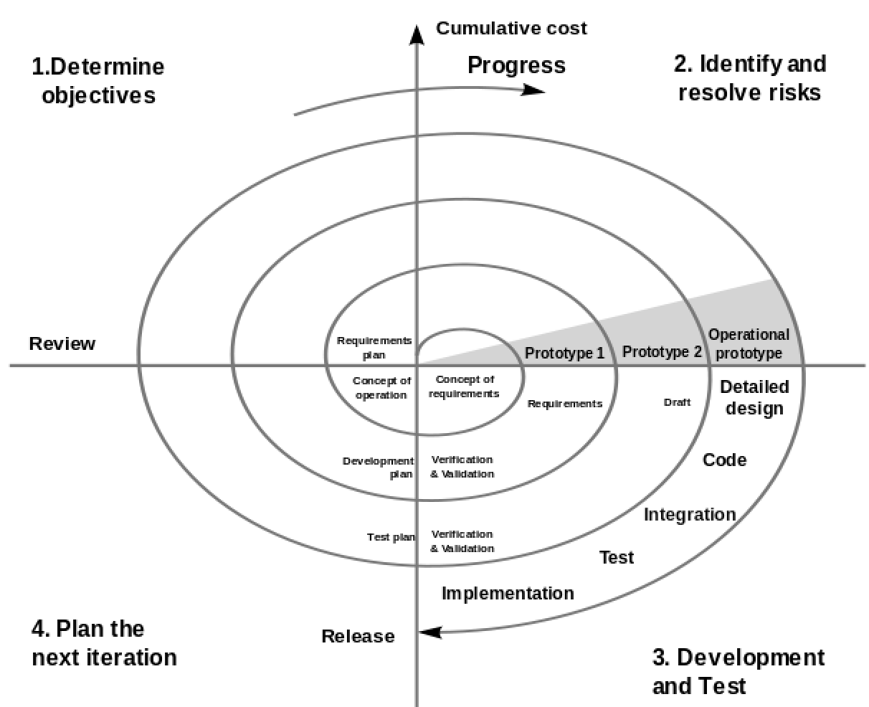
Boehm’s Spiral Model (1986)
Characteristics:
Maintains an ordering of activities
With:
Validation & plan each step
Risk analysis at each step
Notes:
1986 paper "A Spiral Model of Software Development and Enhancement"

Slide 21
Spiral kinds of processes
Draft a menu of program designs
Analyze risk & prototype
Draft a menu of architecture designs
Analyze risk & prototype
Draft a menu of requirements
Analyze risk & prototype
Establish requirements
Plan
Establish architecture
Plan
Operation
Testing
Implementation
Establish program design

Slide 22
Spiral kinds of processes
Draft a menu of program designs
Analyze risk & prototype
Draft a menu of architecture designs
Analyze risk & prototype
Draft a menu of requirements
Analyze risk & prototype
Establish requirements
Plan
Establish architecture
Plan
Operation
Testing
Implementation
Establish program design

Slide 23
Spiral kinds of processes
Draft a menu of program designs
Analyze risk & prototype
Draft a menu of architecture designs
Analyze risk & prototype
Draft a menu of requirements
Analyze risk & prototype
Establish requirements
Plan
Establish architecture
Plan
Operation
Testing
Implementation
Establish program design

Slide 24
Agile kinds of processes
Spike
Sprints
Evaluate & control risk
Customer provides “stories” (short requirement snippets)
Prioritize stories and plan
Write/run/modify unit tests
Operation
Implement
System and acceptance tests
(Agile processes are rarely this tidy in practice)
Notes:
http://www.scaledagileframework.com/spikes/
Spikes additional research on a story before it enters sprint: Technical spike: research technical approaches – build vs. buy. Functional Spike: build a prototype to get user input.
Sprints: Define, build, test: Typically a 2 week time box.

Slide 25
Agile Methods: Examples of Agile Process
Scrum:
Lean Methodology:
Kanban:
Extreme programming (XP):
Crystal:
Dynamic Systems Development Method (DSDM)
Feature-Driven Development (FDD)
https://www.versionone.com/agile-101/agile-methodologies/
Notes:
https://www.versionone.com/agile-101/agile-methodologies/
Visualize what you do today (workflow): seeing all the items in context of each other can be very informative
Limit the amount of work in progress (WIP): this helps balance the flow-based approach so teams don ‘t start and commit to too much work at once
Enhance flow: when something is finished, the next highest thing from the backlog is pulled into play

Slide 26
Agile Methods: Examples of Agile Process
Scrum: 4 week iterations; cross-functional teams; daily “scrum” coordination
Lean Methodology: select truly valuable features, prioritize, and deliver in small batches
Kanban: visualize work-items in context, reduce WIP, enhance flow
Extreme programming (XP): close customer involvement, pair programming, small increments..
https://www.versionone.com/agile-101/agile-methodologies/
Notes:
https://www.versionone.com/agile-101/agile-methodologies/
Visualize what you do today (workflow): seeing all the items in context of each other can be very informative
Limit the amount of work in progress (WIP): this helps balance the flow-based approach so teams don ‘t start and commit to too much work at once
Enhance flow: when something is finished, the next highest thing from the backlog is pulled into play

Slide 27
Contrasting these kinds of processes
 | Waterfall | Spiral | Agile
Emphasizes: | Simplicity Traceability | -Risk management -Exploring alternatives | -Flexibility -Immediacy
Weakness: | Requirement/design mistakes can be costly | Exploring alternatives can be costly | Continual rework can be costly
Style: | -Highly controlled -High ceremony | -Moderately controlled -Moderate ceremony | -Rapid & organic -Low ceremony
Some definitions
“traceability”: relationships between requirements and system elements are documented
“immediacy”: getting some sort of working system to the customer as fast as possible
“rework”: redesigning the architecture and/or refactoring the program code
“controlled”: conformance to process is highly valued, even if it slows a project down
“ceremony”: how much analysis, documentation, and planning is involved

Slide 28
When to choose a particular kind of process
Waterfall is often a good choice for small systems whose requirements can be fully understood before any design or coding.
Spiral is often a good choice for larger systems with vague requirements and many alternatives for designing and coding.
Agile is often a good choice for systems where you can rapidly create something very small but useful, and then expand from there.
Notes:
Write on board

Slide 29
What kind of process would you prefer to use for…?
A nuclear missile’s guidance system
A web server (plain old http)
A web site for people to request prayer
A program that screen-scrapes Google News to watch for ebola outbreaks
A program to steer the Mars rovers
A controller for a sprinkler system so the lawn gets less water on rainy days
Notes:
Work in pairs

Slide 30
Other Flavors
Rapid Prototyping
Get the system characteristic and design done pretty well
Then implement the system
Iterative
Get the whole system working pretty well
Then add features throughout the system
Incremental
Get part of the system working really well
Then add more parts to the system
You can mix & match iterative/incremental with waterfall/spiral/agile. E.g.: iterative agile

Slide 31
Rapid Prototyping / Waterfall
Rapid Prototype
Requirements
Design
Implementation
Testing
Deployment
Characteristics: Use a prototype built and discarded to inform requirements and design specification

Slide 32
Incremental Delivery / Waterfall
Characteristics:
Complete design
Incremental feature delivery
Always providing a working version to the client
Integration of COTS-centric philosophy
Integrate COTS components for certain features
Requirements
Design
Incremental Delivery of Features
Implementation
Testing
Deployment
Notes:
Commercial off the shelf
overall system development and costs (as components can be bought or licensed instead of being developed from scratch) and reduced long-term maintenance costs
initial cost and development time can definitely be reduced, but often at the expense of an increase in software component-integration work and a dependency on third-party component vendors

Slide 33
How to decide on iterative vs. incremental development
It all comes down to where the system’s value is:
Incremental is often good when most of a system’s value is tightly concentrated in a small number of components.
Iterative is often good when you need to implement most of a system before you can get much value.

Slide 34
Suppose we have a customer who says he wants an “eco-friendly Amazon.com”

Slide 35
Example: Incremental spiral development of an e-commerce site
Suppose we have a customer who says he wants an “eco-friendly Amazon.com”
Why pick spiral over waterfall or agile?
Sounds pretty big, with vague requirements and lots of alternatives

Slide 36
Draft a menu of requirements
Should have a shopping cart, etc., obviously.
What does “eco-friendly” mean?
Search based on product “ecofriendliness” rating?
Collect data from producers?
Collect ratings from watchdog organizations?
Collect ratings from customers?
“Eco-friendly” “shipping options”?
Features for swapping/trading items?

Slide 37









Review prototypes with customer (and/or users), document the results
Paper prototypes
Lightweight prototypes
Documentation
These “throwaway” prototypes are cheap to make because they are usually not interactive.
Let’s suppose that the customer settles on eco-friendliness options based on watchdog data.
http://www.flickr.com/photos/carolshergold/1748174721/sizes/o/ http://www.flickr.com/photos/carolshergold/1920638621/sizes/o/ http://www.flickr.com/photos/carolshergold/1921464196/sizes/o/

Slide 38
Draft a menu of architectures
Watchdog users
Web application
Watchdog data input screens
E-commerce interface
Database
Shopping users
PHP/Apache
Mysql
Linux
Watchdog XML feeds
Scrapers to read watchdog data
Shopping users
E-commerce interface
Database
PHP/Apache
Mysql
Linux

Slide 39



Review prototypes with customer (and/or users), document the results
More prototypes
And now an XML mockup
Documentation
And lots of analysis & discussion about pros/cons/cost/schedule/etc.
Let’s suppose that the XML feed architecture is selected, omitting XML feeds for now (to be added in later increment).

Slide 40
Draft a menu of program designs
E-commerce interface
Make each product its own object?
Make each user account its own object?
“Hide” the database from the UI code?
What code should be put into “library” classes for reuse in future increments (e.g.: XML feeds)?
……

Slide 41
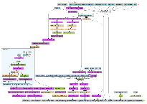
Review prototypes with customer (and/or users), document the results
Heavyweight prototypes
Documentation
These prototypes are pretty expensive to make, since they implement some interactivity.
Therefore, they often are incorporated into the finished product (“evolutionary” prototypes).
http://www.flickr.com/photos/dullhunk/428079229/sizes/l/in/set-72157618027570984/

Slide 42
Implementation, Testing, Operation
Wrap up increment #1
Manually load database with product data (including ecofriendliness data)
Finish coding basic UI for searching/ordering
Write tests, run tests, fix bugs, test some more
Deliver code to customer
Customer tests the code some more
Fix bugs, test, fix bugs, test
Deploy to public server
Fix bugs, test, fix bugs, test

Slide 43
Increment #2: load eco-data from XML feeds
We already know this requirement—no need to return to the requirements phase for this!
Return to review the alternative architectures
Create a menu of program designs, prototype and review, implement, test, send to operation, etc

Slide 44
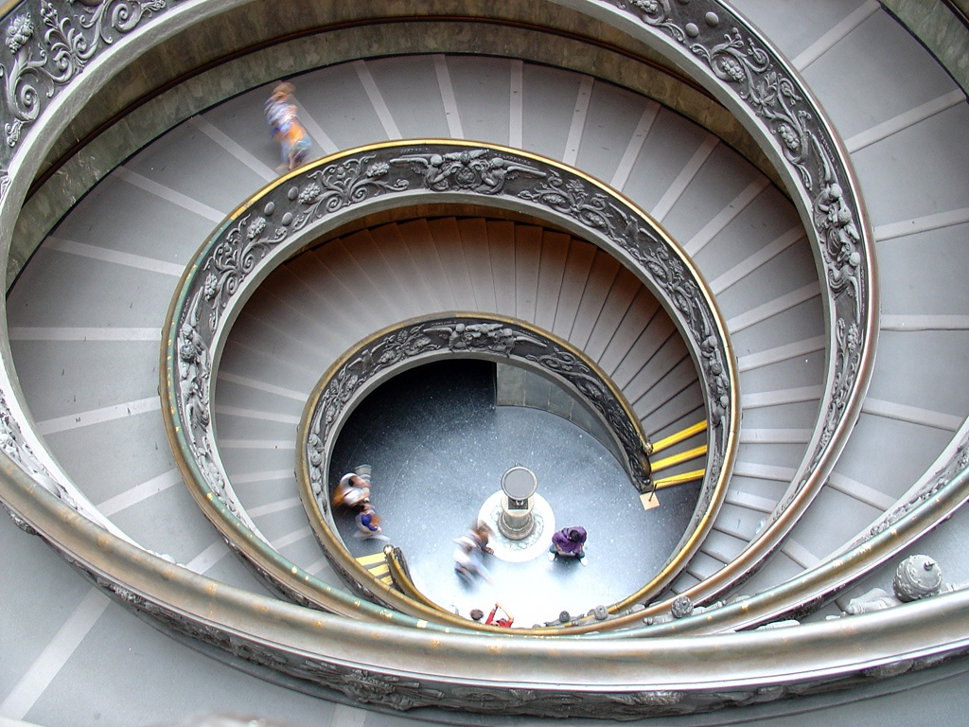
Increment #3 and beyond
Pay attention to users, discover new requirements - Spiral, spiral, spiral
http://www.flickr.com/photos/villes/696080093/sizes/o/

Slide 45
What’s next for you?
Submit your Vision Statements
Canvas assignment
Vote online for vision statements:
Which visions capture your imagination???
No, you cannot vote for your own.
You can vote for more than one (for a few – max 5)
We’ll assign you to a team, based on your vote(s)
One vision per team: that’s the system that your team will design using a waterfall process
Teams assigned…(next) Monday!!!
Open Piazza posts to introduce yourselves?
Voting through Google Forms - instructions will be announced soon…

